Slide 1
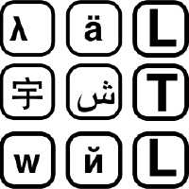



Which Melbourne? Augmenting Geocoding with Maps
Language Technology Lab, University of Cambridge
Milan Gritta, Mohammad Taher Pilehvar, Nigel Collier

Slide 2
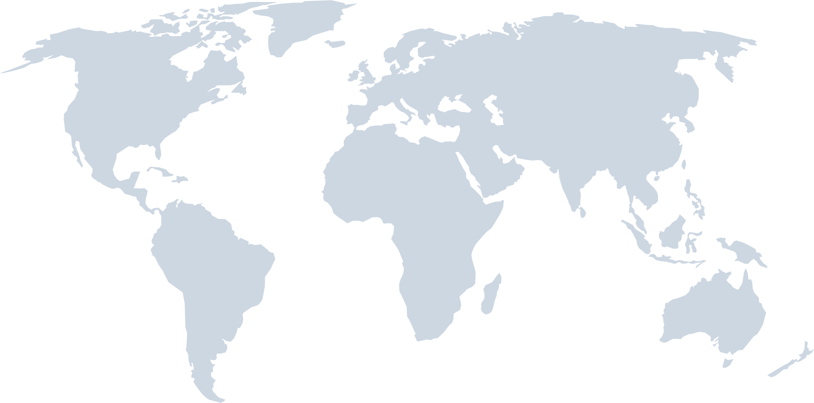

GOAL: Geolocation of text.
Geoparsing Pipeline:
BREAKING NEWS!!!
NER
GEOTAGGING
NEL + WSD
GEOCODING
Incident outside Melbourne’s Sully’s Backstreet Bar. Suspect taken to the Brevard County Jail.
Reference Geocoding
Document Geocoding
Geocoding or Toponym Resolution

Slide 3
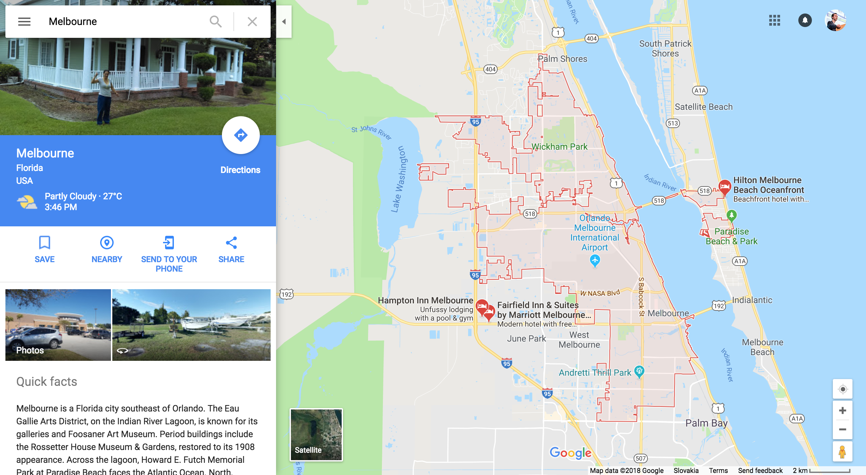
BREAKING NEWS!!!
Incident outside Melbourne’s Sully’s Backstreet Bar. Suspect taken to the Brevard County Jail.

Slide 4
Background Geoparsing Systems
RULE-based SYSTEMS
CLAVIN (Open-Source, v2016) – NER
Edinburgh Parser (Grover et al. 2010) v2016
GeoTxt (Karimzadeh et al. 2013) v2016 – NER
Population Baseline (choose highest population)
Geocoding similar to WSD but…
Ambiguity of toponyms greater (e.g. 10+ Melbournes in the world)
Contextual clues not adequate or missing for small (local) places
Often difficult for humans to judge
50% - 75% resolved by population
Statistical (& closed source)
Topocluster (De Lozier et al. 2015) v2016 - NER
Yahoo! Placemaker (Proprietary Algorithm)
Machine (deep) learning
LambdaMART (Santos et al. 2015) (no source)
CamCoder (Gritta et al. 2018) v2018 - NER

Slide 5
The Map Vector
Bag of words.
1 TEXT DOCUMENT,
2 SETS OF FEATURES
Lexical
Footprint
MELBOURNE
SUSPECT
INCIDENT
OUTSIDE
TAKEN
BAR
PLACE
SULLY’S
0.5
0.6
1.0
0.1
0.4
0
0.2
0.9
LONGITUDE
0
0
0
0
0
0
0
0
Geographic
Footprint
0
0.8
0
0.2
1.0
0.6
0
0
0
0.2
0.3
0
0
0
0.9
0
LATITUDE
180 DEGREES
0
0.1
0
0
0.1
0
0
0
(reshape to) 1D Map Vector
0
0
0.4
0
0.9
0.5
0.6
0
0
0
0
0
0
0
0
0
360 DEGREES
Bag of locations.

Slide 6
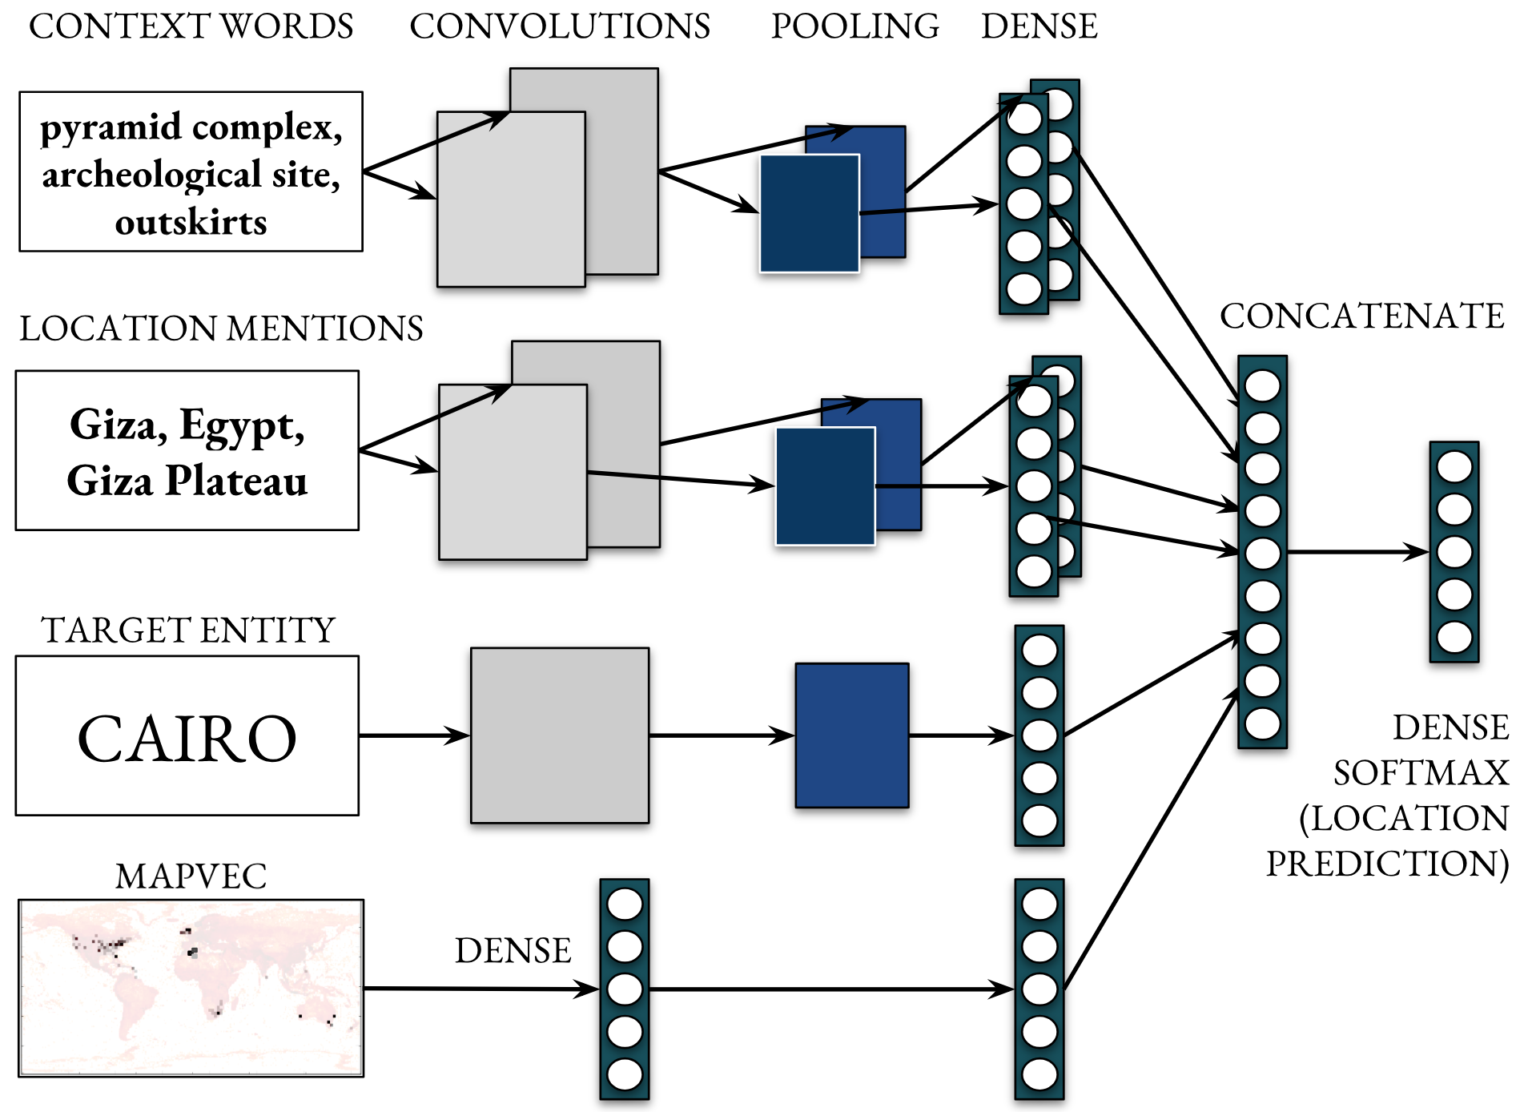
ARTICLE.COM
Map
7,823D
The Giza pyramid complex is an archaeological site on the Giza Plateau, on the outskirts of Cairo, Egypt.

Slide 7
Evaluation Datasets
LOCAL GLOBAL LEXICON (LGL) by (Lieberman et al. 2010) – packaged with our code.
588 local news articles from global sources
4460 annotated places, Medium Difficulty Test
WIKIPEDIA TOPONYM RETRIEVAL (WikToR) by (Gritta et al. 2017) – also packaged with our code.
Wikipedia-based geoparsing of 5,000 articles
High Difficulty Test, 25,000+ locations in total
Other corpora available (De Lozier et al. 2010), (Wallgrun et al. 2017), (Buscaldi and Rosso 2008), (De Oliveira et al. 2017), (Mani et al. 2010), (Eisenstein et al. 2010) but issues with cost, scope, annotation, size, type of task, completeness, etc.
OR RESOURCES NOT PUBLISHED WITH PAPER

Slide 8


GeoVirus.xml New Dataset
229 articles (August, September 2017)
NER/Geotagging and Geocoding
KEYWORDS: Ebola, Bird Flu, Swine Flu, AIDS, Mad Cow Disease, many more. (Medisys JRC)
Locations: 2,167, Word Count: 63,205
https://github.com/milangritta
DOWNLOAD

Slide 9
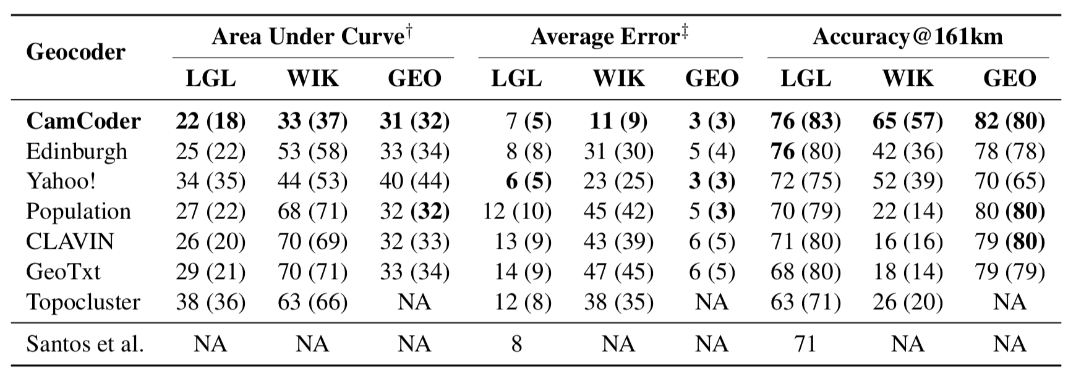
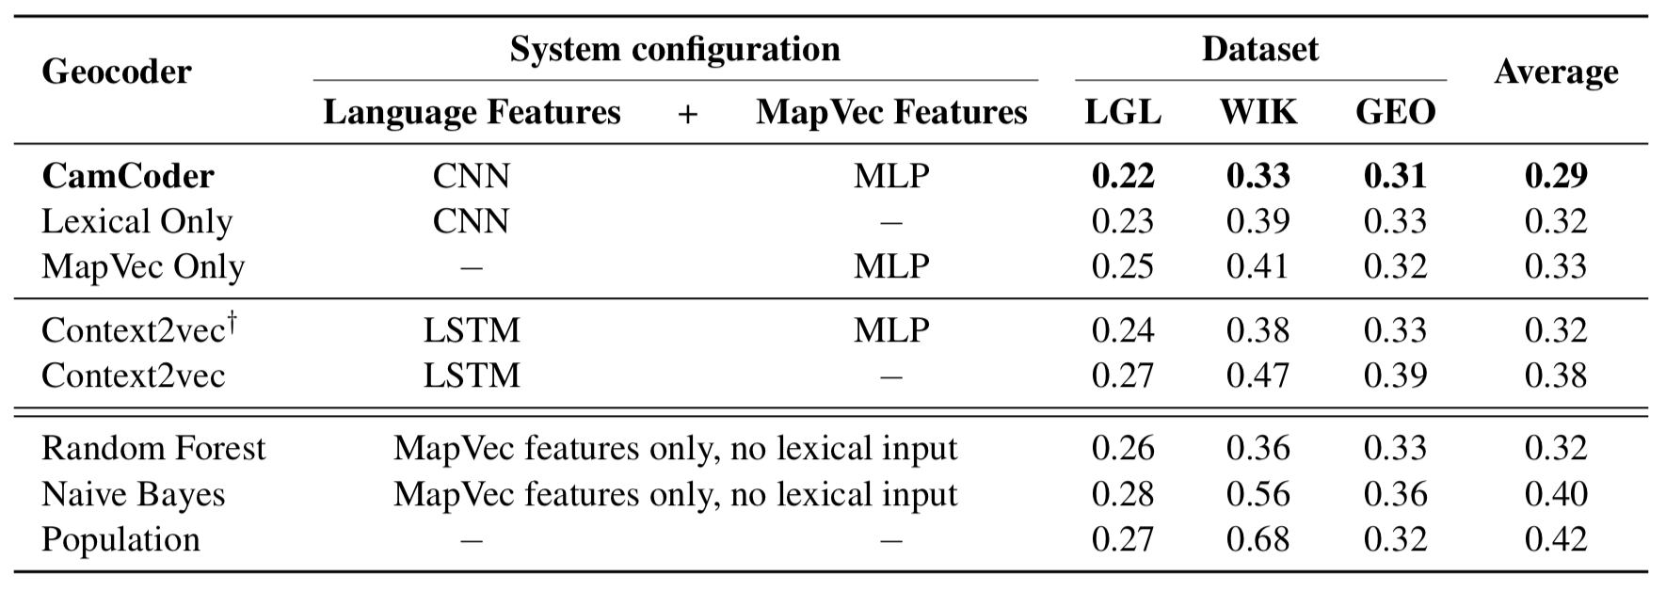
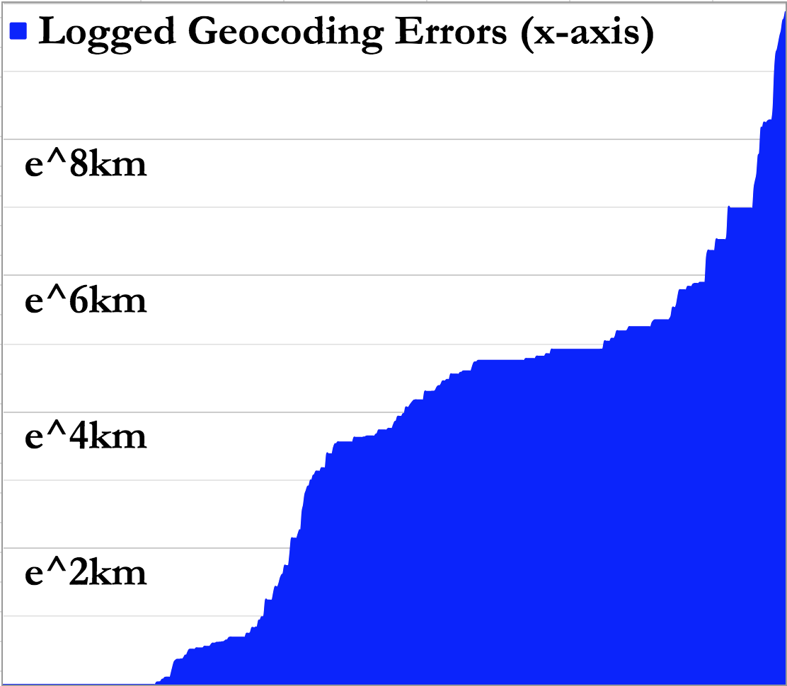
EVALUATION Table 1 & 2
OVERALL PERFORMANCE COMPARISON
MODEL BREAKDOWN AND ABLATION
Area Under the Curve

Slide 10
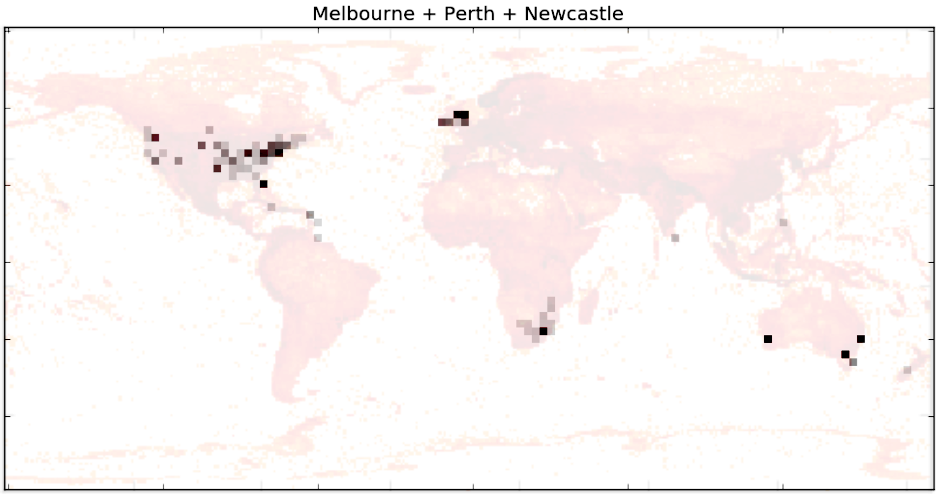
Summary of Contributions
GeoVirus.xml
The Map Vector
CamCoder
Lexical CNN Geocoder
Notes:
(1) Lexical CNN Geocoder outperforming existing systems by analysing only the textual context;
(2) MapVec, a geographic representation of locations using a sparse, probabilistic vector to extract and isolate spatial features;
(3) CamCoder, a novel geocoder that exploits both lexical and geographic knowledge producing SOTA results across multiple datasets;
(4) GeoVirus, an open-source dataset for the evaluation of geoparsing (Location Recognition and Disambiguation) of news events covering global disease outbreaks and epidemics.

Slide 11



Money enables much Scientific Research. Thank You!
www.DREAM-CDT.ac.uk
www.NERC.ac.uk
https://ESRC.ukri.org/

Slide 12
THANK YOU and CHECK OUT THE PAPER. https://github.com/milangritta
Language Technology Lab, University of Cambridge
Questions?

